Slide 1
Wreningham Primary School
SEND Information Report 2022-2023
Publication Date: November 2022
Review date November 2023
At Wreningham VC Primary School we believe that Together Everyone Achieves More. We are committed to creating an inclusive culture where all members of our school community work together. We are committed to the equal inclusion of all children in all areas of school life. We recognise the diverse and individual needs of all of our children and take into account the additional support required by those children with Special Educational Needs and Disabilities (SEND).
The SEND Information Report describes the range of provision and support available to support identified children as and when appropriate. This is subject to change depending on budgetary constraints and policy review. The school follows the Wymondham Cluster SEND Policy and can be accessed here.

Slide 2
SEND Information Report Contents
Who can I contact regarding concerns about SEND?
What is SEND?
What kinds of SEND do we support?
What is the difference between SEN support and an Educational Health Care Plan?
What is our SEND profile for 2022-2023?
How do we identify the special educational needs of children?
What is our approach to teaching children with SEN? - Cognition and Learning
What is our approach to teaching children with SEN? - Communication and Interaction
What is our approach to teaching children with SEN? – Social, Emotional and Mental Health
What is our approach to teaching children with SEN? - Sensory and Physical
What is our approach to teaching children with SEN? Emotional Literacy Support (ELSA)
What is our approach to teaching children with SEN? - SEN and EAL
What is our approach to supporting children with medical needs?
What is our approach to teaching learners with SEN? - Specialists and External Agencies
How do we assess and review children’s progress? - Assess, Plan, Do Review Cycle
How do we assess and review children’s progress?
How do we assess and review children’s progress? – Assessment Tools
How do we assess and review children’s progress? - Applying for an Education, Health and Care Plan (EHCP)
What are our roles and responsibilities?
How do we support the Children, Parents and Carers?
What additional support is available to children with SEN?
How do we prepare children for their next steps?
What SEN training opportunities have the staff received?
What support services are available for parents and carers of children with SEN?
Other useful links
How has school funding supported SEN provision?
What is the Norfolk Local Offer?
Have your say

Slide 3
School Contact Information
If you wish to discuss our SEND provision further, please contact us:
Head Teacher: Mr Rob Jones
Email - (head@wreningham.norfolk.sch.uk)
SENCO: Ms Julie Leader
Email - (SENCO@wreningham.norfolk.sch.uk)
SEND Governor: Ms Katie Burrell
Email - (office@wreningham.norfolk.sch.uk)
School Phone Number: 01508 489355

Slide 4
What is SEND?
Some of our pupils may require additional support so that they can access the curriculum and make progress at their own level.
At different times in their school career, a child or young person may have a special educational need. The Code of Practice (2015) defines SEN as:
“A child or young person has SEN if they have a learning difficulty or disability which calls for special educational provision to be made for them. A child of compulsory school age or a young person has a learning difficulty or disability if they:
have a significantly greater difficulty in learning than the majority of others of the same age; or
have a disability which prevents or hinders them from making use of educational facilities of a kind generally provided for others of the same age in mainstream schools or mainstream post-16 institutions.”
If a learner is identified as having SEND, we will work closely with the pupil and their parents to provide provision that is ‘additional to or different from’ the normal differentiated curriculum, intended to overcome the barrier to their learning.

Slide 5
What kinds of SEND do we support?
The SEND Code of Practice (2015) outlines 4 broad areas of need, as outlined below. “These four broad areas give an overview of the range of needs that should be planned for. The purpose of identification is to work out what action the school needs to take, and not to fit a pupil into a category. In practice, individual children or young people often have needs that cut across all these areas and their needs may change over time.” (SEND Code of Practice, 2015)
Cognition and Learning
Children may:
Learn at a slower pace
Find the curriculum difficult
Struggle with organisation and memory
Have a specific difficulty in literacy or numeracy eg Dyslexia, Dyscalculia
Sensory and/or Physical
Children may have a:
Vision impairment
Hearing impairment
Multi-sensory impairment
Motor skill difficulties
Physical disability
Social, Emotional and Mental Health Difficulties
Children may:
Find relationships difficult, appear withdrawn or isolated
Behave in ways which affect their learning
Have underlying mental health difficulties such as anxiety, depression, self-harming, eating disorders
Have ADD, ADHD, Attachment issues
Communication and Interaction
Children may:
Struggle to speak or say what they want to
Find it hard to understand what others are saying
Find conversations and play confusing and challenging
Have a diagnosis of Autism Spectrum Disorder (ASD)
Some children may have SEND which involves more than one of these areas.

Slide 6
What is the difference between SEN support and an Educational Health Care Plan?
SEN support is a staged approach to identifying needs and providing support. This will include conversations between school, parents and children. The support may be that which is generally given to most children of the same age. The purpose of SEN support is to help children make progress. Children who have been identified as needing SEN support will have an individual learning plan (IP), which outlines targets for children to work towards and strategies to support this. IPs are reviewed termly with children and families being actively involved in the planning process.
The majority of children with SEN or disabilities will have their needs met through SEN support. However, some children’s needs may require them to have an Education, Health and Care Plan (EHCP). EHCPs are for those children with special educational needs who require support beyond that which a school can provide at SEN support. An EHCP is a legal document, written by the Local Authority, that describes a child’s special educational needs and the help they will get to meet them. This also includes health and social care needs. Children with an EHCP will have an individual learning plan. The targets within the learning plan will outline the smaller steps the child is working on towards achieving the outcomes outlined in the EHCP. Children with SEN and their families will be actively involved in the creation and review of learning plans, by sharing their wishes, feelings and opinions. Children with SEN and their families will also be actively involved in the annual review of the EHCP, by sharing their opinions on the provision and outcomes outlined

Slide 7
What is our SEN profile for 2022 – 2023?
In the academic year 2022-2023, 16% (National 13%) of children identified as having SEND.
39% have medical needs (6% of school)
67% have additional needs related to Cognition and Learning (11% of school)
11% have Educational Health Care Plans (2% of school).
Some of our children have needs in more than one group (e.g. a child with dyslexia may need support with communication and interaction as well as those related to cognition and learning), percentages show the primary need.
12 pupils Cognitive and Learning
3 pupils Social, Mental and Emotional
3 pupils Communication and Interaction
7 pupils Sensory and/or Physical

Slide 8
How do we identify the special educational needs of children?
Where pupils’ progress is significantly slower than their peers, or fails to match their previous rate of progress, despite high quality first teaching targeted at specific areas of difficulty, it may be that the child has SEND. Information will be gathered, including seeking the views of parents and the pupil, as well as from teachers and assessments.
There can be a many reasons for learners ‘falling behind.’ These may include absences, attending lots of different schools, difficulties with speaking English, emotional stress or worries that distract them from learning. Children who experience such barriers to learning are vulnerable, but this does not mean that all vulnerable learners have SEND. Only those with a learning difficulty that requires special educational provision ‘additional to’ or ‘different from’ the usual differentiated curricular will be identified as having SEND.
Once a child is identified as having SEND we follow an ASSESS-PLAN-DO & REVIEW cycle. This involves regular meetings with child and parent to monitor and to assess and review progress and outcomes

Slide 9
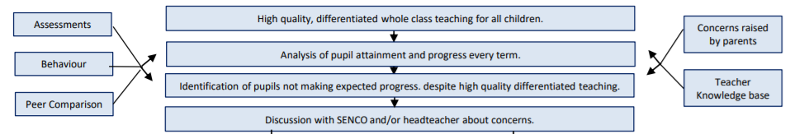
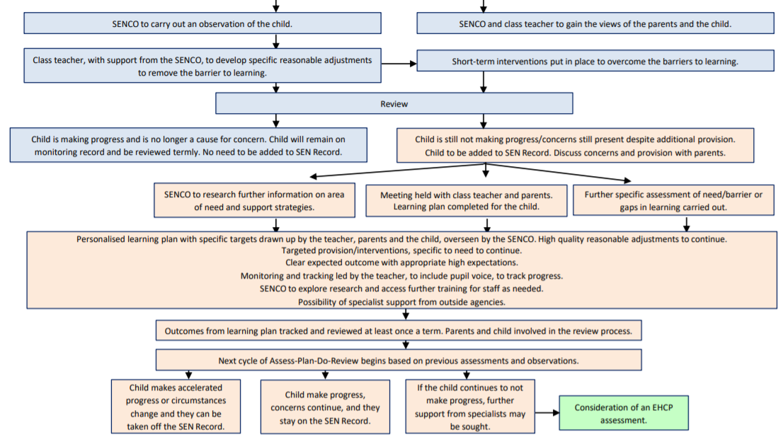
How do we identify the special educational needs of children?

Slide 10
What is our approach to teaching learners with SEN?
We believe in achievement for all and that ’Together Everyone Achieves More’. We aim to create a learning environment which is flexible enough to meet the needs of all pupils, whilst also promoting independent learners. The class teacher remains responsible for working with all children, ensuring they attain and make progress, in line with the Teaching Standards.
Quality First Teaching: High quality teaching, differentiated for individual pupils, is the first step in responding to pupils who may have SEN. Quality first teaching is available to all children in a class. Teachers have the highest expectations for all children in their class. Teaching is planned to build on what children currently know and can do. Different ways of teaching are in place so that children are fully involved in learning in class, through effective challenge and adaptive learning (eg tailored resources, feed back). An inclusive learning environment is created for all children. Specific strategies, which may be suggested by the SENCO or outside agencies, are used to support children with SEN to learn. Staff will keep parents and carers informed of how children are learning, sharing success and concerns. Children’s progress is constantly monitored, assessed and reviewed and any gaps in their understanding and learning will be identified and addressed.
Targeted Interventions: If a specific need is identified a targeted intervention may be planned and delivered. These may be run in the classroom or in separate sessions outside of whole class teaching. They could be delivered by a teacher or a teaching assistant and are often targeted at a group of pupils with similar needs. Targets and anticipated outcomes will be identified before beginning interventions, and their impact will be assessed and reviewed once it is finished.
Specialist, Individual Intervention: For some children it is necessary to provide highly tailored, personalised intervention to meet individual needs. This high level of additional and/or specialised provision is put in place to address children's needs and enable them to learn. Some children will have access to aids and materials to support their learning and meet their needs, such as fiddle toys, wobble cushions and laptops.
Provision maps are created, showing the provision on offer. These are evaluated to ensure the range of needs are addressed. Impact of interventions and support is reviewed as part of the ‘assess, plan, do, review’ cycle. Observations of teaching and learning walks may focus on the teaching and learning of pupils with SEN.

Slide 11

What is our approach to teaching children with SEN? - Cognition and Learning
Difficulties | Quality First Teaching | Targeted Intervention | Individual Support | External Support Agencies
Reading and spelling Learning new information and concepts Working with numbers Working memory Concentration Children with a specific diagnosis eg dyslexia Children who present with difficulties which have no specific title | Differentiated curriculum, delivery, planning and work Displays and working walls Help mats, checklists Labelled resources Maths resource boxes Numicon Modelling Next step marking Personalised learning Pre and post learning Questioning Seating plans Step by step instructions Success criteria – small steps Visual aids and resources Writing frames Reading/spelling tests Dyslexia friendly displays, paper and whiteboard screens | Small group interventions (catch up reading, precision teaching, Numicon) Lexia Use of ICT and technology Guided groups- reading, writing and maths Small group phonics In class TA Paired work/peer mentoring Pre and post teaching | One to one teaching – phonics, reading, maths, writing Additional time for tests and assessments Access to technology Speech to text software Coloured overlays, reading rulers and exercise books Pencil grips Sloping writing desks Differentiated homework Pre and post teaching Scribes Enhanced transition | Norfolk Educational Psychology Dyslexia Outreach British Dyslexia Association School2School Service Cognition and Learning SRBs

Slide 12

What is our approach to teaching children with SEN? - Communication and Interaction
Difficulties | Quality First Teaching | Targeted Interventions | Individual Support | External Support Agencies
Understanding language Using language Understanding how to communicate socially with other people Conditions include: Specific Language Disorder, ASD (Autism), speech sound disorders/delay Stammering | Circle time Differentiation delivery pace outcome questioning grouping Displays – visual – symbols Labelled resources with picture and name Processing time Routines Seating plans Signing in whole class sessions (if needed) Simplified language Use of TA Visual timetables Visualiser Printed instructions and checklists | In class TA support Memory work Pre/post teaching Quiet room for S&L Reading partners Small group ‘talk’ groups | Additional time for tests/assessments ASD support Access through technology Speech to text ELSA Social stories Art therapy Nurture Taskboards PECs Visual timetables Enhanced transition | Norfolk Educational Psychology School2School Service Speech and Language Therapy Speech and Language SRBs Autism Education Trust The Communication Trust Helping Hands Autism Anglia

Slide 13

What is our approach to teaching children with SEN? – Social, Emotional and Mental Health
Difficulties | Quality First Teaching | Targeted Intervention | Individual Support | External Support Agencies
Forming and maintaining relationships Bereavement Attitudes to attainment Attendance Self-esteem Life outside school | Anti-bullying policy Celebration assemblies Circle Time Class Rules Class Worry Boxes House points/Dojos Parent Questionnaires Pupil questionnaires School Behaviour Policy Rewards and Sanctions School Council RSHE curriculum Seating plans Social Stories Traffic Lights Behaviour System Use of TA Trusted Adult | Peer Mediators (playtime) Circle of Friends groups Nurture ELSA In class TA support Small group circle time Social Stories | Behaviour logs Drawing and talking ELSA Family Support Plans (FSPs) Art therapy Stepping Stones training Positive behaviour plan Reward charts Risk assessments Sensory Circuits Social Stories Zones of Regulation Enhanced transition | Norfolk Educational Psychology School2School Service Norfolk SEMH SRBs Norfolk Early Help CAHMS Point 1 Just One Number Benjamin Foundation Norfolk Inclusion Team Nelson’s Journey ADHD Norfolk Young Minds

Slide 14

What is our approach to teaching children with SEN? - Sensory and Physical
Difficulties | Quality First Teaching | Targeted Intervention | Individual Support | External Support Agencies
Visual impairment Hearing impairment Gross motor difficulties Fine motor difficulties Self-organisation for daily living Diagnosed conditions such as dyspraxia, MCT, chronic fatigue syndrome | Coloured whiteboard Displays – choice of font Flexible teaching arrangements Large print Left handed equipment Left handed seating Matt laminates for displays (where necessary) Specific resources in class Seating plans – for sight, hearing and mobility Teacher aware (positioning, speech) Water available Ramps Non-slip floors Handrails Clear walkways | Adapted games in PE Sensory Circuits Handwriting groups In class TA support Cross lateral activities | Enlarged texts Braille Hearing loop technology Health Care Plans Coloured overlays, whiteboards, paper, exercise books Ear defenders Equipment –scissors, slopes, pencils, pencil grips, cushions, footstools, chairs Magnifiers Medical support Movement breaks Physio/OT Sensory support advice Screens for workstation Sensory circuits Talking tins Use of disabled toilet Quiet area Enhanced transition | Norfolk Educational Psychology School2School Service Virtual School Sensory Support (VSSS) SENSi Access Through Technology

Slide 15

What is our approach to teaching children with SEN? Emotional Literacy Support (ELSA)
We recognise children cannot learn when they have low self-esteem, are anxious or don’t feel safe and secure. We have a very caring staff at Wreningham who provide high quality pastoral care on a daily basis for all the children in their classes. There may be times however, when children need more targeted emotional support and we have two Emotional Literacy Support Assistants (ELSA) who work with individuals and small groups of children. The ELSAs are trained and supervised by psychologists on a termly basis.
In ELSA sessions we aim to provide support for a wide range of emotional needs including:
Recognising, naming and describing emotions
Building self-esteem and positive learning behaviours
Social skills
Friendship skills
Anger management
Loss and bereavement

Slide 16
What is our approach to teaching children with SEN? - SEN and EAL
“Identifying and assessing SEN for young children whose first language is not English requires particular care.” (SEND Code of Practice, 2015)
There can be many advantages in speaking more than one language. We recognise and value all languages. When a child who is learning English as an additional language makes slower progress it is important to understand the cause of the concern. It is important to check on the child’s ability to deal with the language demands of the environment, through observations and assessment, before making assumptions. This will enable school to determine if the delay is related to learning English as an additional language or if it arises from SEN or disability.
If a child with English as an additional language has an identified special educational needs, they will receive the same support and provision as other children. As far as possible support and advice will be provided in the child’s home language, whilst also supporting the child to develop their English language skills.

Slide 17

What is our approach to supporting children with medical needs?
Children with medical needs will be provided with a detailed Health Care Plan, compiled in conjunction with medical professionals, parents/carers and where possible the children themselves.
All staff who work with the children receive first aid training and where necessary, specific medical training by the relevant professionals e.g. in the case of Type 1 Diabetes, Haemophilia.
Some children may miss long periods of learning due to their medical needs. In these cases, home learning will be provided by the school and the child will be referred to the Norfolk Medical Needs team for additional support. For more information visit:
https://www.schools.norfolk.gov.uk/pupil-needs/health-needs/medical-needs-service
All staff administering medicine adhere to the guidelines set out in the school’s medicine administration policy.

Slide 18
What is our approach to teaching learners with SEN? - Specialists and External Agencies
Our school values the opinion and advice of external agencies. Wherever possible we will accommodate the suggestions made by other professionals. Some of the specialist teams that we may work alongside include:
Access Through Technology | Supporting children to use technology to communicate and to learn. They provide assessment, equipment, advice, support and training.
CAMHS Child & Adolescent Mental Health Services= | Assessing and supporting children and young adults with acute anxiety and mental health issues
Dyslexia Outreach Support | Offering accessible, relevant and practical support to schools with regards to their provision for dyslexic learners. This can include model teacher, action plans around specific children, strategies for mainstream and small group teaching and advice on assistive technology.
Nelsons Journey | Bereavement network, supporting children and families through the loss of loved ones.
Norfolk Early Help | Also known as early intervention, is support given to a family when a problem first emerges. It can be provided at any stage in a child or young person's life.
Educational Psychologists | EPSS provide our contact for Educational Psychology services. An EP can carry out observations and further assessments to identify barriers to learning and underlying needs.
Speech and Language | Referrals can be made to Norfolk and Waveney Children and Young People’s Health Services. A speech therapist can carry out a detailed assessment of speech, language and/or communication needs and will provide follow up activities and intervention.
Paediatricians | For health needs and referrals to other services, such as the Neurodevelopmental Team for ASD and ADHD concerns
Physiotherapists | Providing specialist assessment and intervention to children who have a range of conditions involving physical or movement difficulties which limit their mobility, function and/or independence.
School 2 School Support | A support service offered by the consortium of Norfolk Complex Needs Schools. They offer support to school staff and learners to develop a climate of opportunity and success for all. This includes observations and recommendations in relation to pupils learning environment, curriculum or resources, training for key staff, modelling strategies and approaches to meet individual need, support in connect with a specific child or a wider whole school issue.
School Nursing Team (Just One Number) | Just One Number is our single point of access for all Norfolk Healthy Child Programme services. If you need advice about your child or young person’s health or wellbeing, simply send a text and one of our team will text you back.
Virtual School Sensory Support | The Sensory Support Unit aims to promote the inclusion, well being and quality of life for residents of Norfolk who have a sensory loss. The unit provides social care assessments for people who are deaf or have a dual sensory loss. It also provides an assessment and rehabilitation service where sight loss has become a critical or substantial barrier to independent living.

Slide 19
How do we assess and review children’s progress? - Assess, Plan, Do Review Cycle
Monitoring progress is an integral part of teaching and leadership at Wreningham Primary School. We follow the ‘assess, plan, do review’ model, involving parents/carers and children in the process through discussions and structured conversations.
Assess Children are identified as needing support when:
Concerns are raised by parents/carers, external agencies, teachers, the child’s previous school or the child
Screening assessments indicate a gap in knowledge and/or skills
Pupil progress meetings highlighting attainment outcomes indicate lack of expected rate of progress
Observation of the child indicates they have additional needs
Review Support given to the child is measured and the impact is assessed. Children, parents and carers are included in the review process as part of planning an IP. It is decided at this stage whether further support is needed.
Assess
Plan This involves discussing, planning and agreeing what will be put in place following the assessment. We identify specific teaching strategies, approaches and resources to help the child. Once support is agreed, it is recorded and shared via the IP.
Plan
Review
Do
Do This is the implementation of the support. This may include:
Delivering high quality teaching
Delivering a personalised curriculum
Providing additional resources
Working in a small intervention group

Slide 20
How do we assess and review children’s progress?
In years 1 –6 children complete written assessments in: Maths Reading Writing Spelling These are completed three times a year.
In EYFS, teacher assessment is on-going, with data drops three times a year. At then end of Reception, the children are assessed against the Early Learning Goals.
Informal assessment tasks are completed throughout the year. These are used, alongside teacher assessment, to assess children’s attainment in foundation subjects once a year.
Analysis of assessment data and teacher observations contribute towards individualised targets on individual learning plans. Learning plans are written and reviewed at least three times a year. This is completed in collaboration with the child and their parents/carers. Assessment data is used to inform pupil progress meetings.
The SENCO and HT track the attainment and progress of all SEN children in Reception to year 6, three times a year. Areas for concern are identified and fed back to class teachers for action.
Assessment results are analysed by the class teacher and used to inform future planning, provision and intervention.
Data from assessments is compared against historic school data, in addition to comparisons with local and national statistics.
All children receive a written report at the end of the academic year.
The attainment and progress of pupils with SEN in Reception to Year 6 is reported anonymously to governors, three times a year.
The Engagement Model: Children that are working below the standard of the National Curriculum assessments and that are not engaged in subject-specific study will be assessed against The Engagement Model. Observations will be used to assess children’s development within the five areas of engagements: exploration, realisation, anticipation, persistence and initiation. This will be completed a minimum of three times a year.
EHCP Review Cycle: A review will be held annually for children with an Education, Health and Care Plan. The advice and opinions of the child, the parents/carers, school staff and external agencies (where available) will be incorporated into the annual review. The review focuses on the child’s progress towards achieving the outcomes specified in the plan with next steps for the forthcoming year identified.

Slide 21
How do we assess and review children’s progress? – Assessment Tools
Assessment tools are used to measure progress, based on a specific starting point. Assessment may also be used to identify an underlying need or to support further investigation from external agencies.
Assessment tools used in school and held within Cluster.
Boxall Profile (social, emotional and mental health needs)
Strength and Difficulties Questionnaire (social, emotional and mental health needs)
PUMA (maths assessment)
PIRA (reading assessment)
GAPS (spelling, punctuation and grammar assessment)
Speech Link (speech)
Numicon Maths
Dynamic Assessment (cognition and learning)
SWRT Single Word Reading Test
SWST Sing Word Spelling Test (spelling)
MeeMo (working memory)
Neurodiverse checklist
The assessments in italics are those we share with cluster or are in the process of obtaining.

Slide 22

How do we assess and review children’s progress? - Applying for an Education, Health and Care Plan (EHCP)
“The majority of children and young people with SEN or disabilities will have their needs met within local mainstream early years settings, schools or colleges. Some children and young people may require an EHC needs assessment in order for the local authority to decide whether it is necessary for it to make provision in accordance with an EHC plan” (SEND Code of Practice, 2015)
Where a child has an EHCP, there will be an annual review held in addition to the normal review meetings (structured conversations). Taking into account the views of the child, their parents or carers, and all other professionals involved with the child.
The following people have a right to ask the local authority to conduct an education, health and care needs assessment for a child:
The child’s parent
A young person over the age of 16, but under the age of 25
A person acting on behalf of a school
Children with an EHCP may receive additional funding to support their needs which can be used
by the school to provide resources or external services.

Slide 23
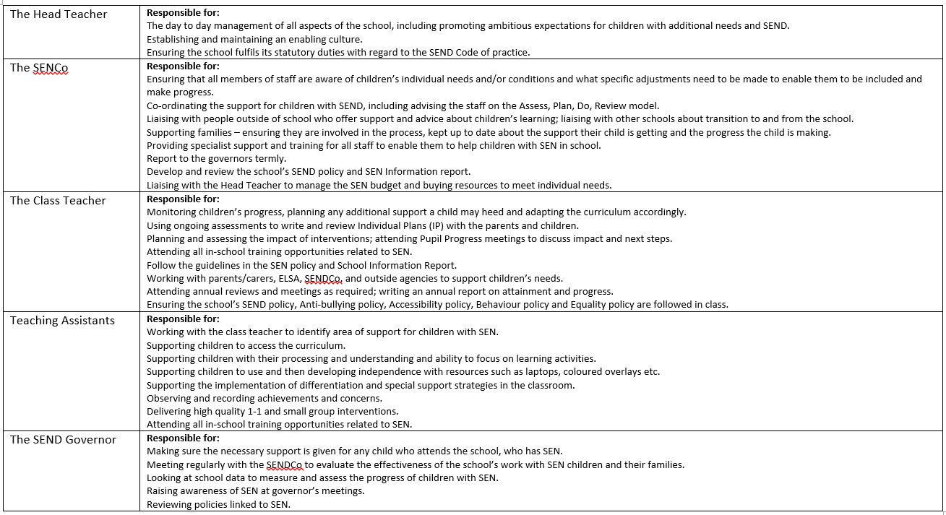
What are our roles and responsibilities?

Slide 24
How do we support the Children, Parents and Carers?
At Wreningham, we aim to build a good relationship and work in partnership with children, parents and carers to enable the best possible care and provision to be implemented to meet children’s needs.
We acknowledge the right of children to have their opinions heard and taken into account, and we support children in ensuring they play an active role in their own education.
Children are supported to:
Contribute termly to their Individual Learning Plan.
Take part in interventions to support their learning.
Use resources in the classroom to support their learning.
Develop independence in their learning, using the resources available to them.
Express their view and opinions in annual questionnaires and wishes and feelings for annual reviews
Parents and carers are supported to:
Attend meetings, parents evenings and reviews to discuss progress and next steps.
Meet and communicate with external agencies involved in the care and education of their children.
Attend annual review meetings for pupils with EHCPs.
Attend structured conversation meetings to discuss and review SEN provision.
Communicate with staff, either in person, email, by phone and where appropriate by a home/school book.

Slide 25
What additional support is available to children with SEN?
Extra-curricular Activities
We strongly believe that all learners are entitled to the same access to extra-curricular activities and are committed to making reasonable adjustments to ensure participation for all.
We offer a range of additional clubs and activities for children from Reception to Year 6. These include:
Football
Sports Club
Music lessons –keyboard, guitar, recorders
Tennis Club
Lego Club
Table Tennis
Board Games
Rugby Club
There is also an extended school offering breakfast and after-school club for all pupils in Reception to Year 6. Please contact our extended school coordinator to discuss specific requirements.
Access Arrangements
We recognise that some children may require alternative arrangements for accessing exams and assessments. This could include, but is not limited to, children that have difficulty reading, writing or concentrating, children with a visual impairment or children with processing difficulties.
Arrangements never advantage or disadvantage a child, and any support given is based on normal classroom practice. Examples of access arrangements could include additional time, scribes, transcripts, word processors, readers, rest breaks and prompters.
Access arrangements are determined on an individual case by case basis.
Medical Needs
Any child that is unable to attend school due to a SEN and/or a medical need will be referred to Norfolk medical needs team and home learning will be provided.
More information on the Norfolk medical needs team can be found using the link below:
https://www.norfolk.gov.uk/children-and-families/send-local-offer/education-and-training-0-25/support-services/medical-needs-education-provision

Slide 26
How do we prepare children for their next steps?
We recognise transition is an important time for all learners and may cause anxiety especially for children with SEND. We work closely with parents/carers, our local nurseries and pre-schools and high schools to ensure transitions run as smoothly as possible.
Moving from nursery/pre-school –
The children are invited to spend three afternoons in school to become familiar with the classroom and the staff. (June/July)
We hold an evening transition information meeting for parents in the summer term before the children start school. (June)
Where possible the class teacher and a teaching assistant visit the children in their current setting before they visit the school (May/June)
Discussions Reception staff and nursery/pre-school staff.
Moving within school –
Transition meetings between parents, children, teachers and other professionals where necessary.
Meet the teacher mornings where the children move into their new class and spend time with their new teacher.
Discussions held between current class teacher and next class teacher, where effective strategies for support are discussed.
Wreningham is a small school, where all members of staff have a deep knowledge and understanding of the children’s needs. This contributes to a positive transition between classes.
Moving to a new school –
Extra visits to the new school to become familiar with the setting, where possible.
Discussions between the SENCOs and a meeting of necessary.
Records of achievements, attainment, progress and outside agency involvement is shared with the new school.
Teachers from the new school may visit where necessary.
Meetings with parents to discuss any concerns or questions.
Children to attend settling in sessions to familiarise themselves with the school, staff and peers.

Slide 27
What SEN training opportunities have the staff received?
The school SENCO has achieved the National Award in Special Educational Needs Coordination
Recent training completed by the staff:
Working memory
Designated Safeguarding Training
Finding and addressing gaps in learning – Maths Recovery in Year One
Spotlight on Year 5 Mathematics
Stepping Stones – Strategies Towards Positive Behaviour
Spotlight on Year 1 Mathematics
SENDCos have a cluster meeting every half term

Slide 28
What support services are available for parents and carers of children with SEN?
Norfolk SENDIASS (Special Educational Needs and Disabilities Information, Advice and Support Service)
This is a free, dedicated, confidential and impartial service based in Norwich.
They provide information, advice and support to children, young people and parents/carers about SEND.
: 01603 704070
: norfolksendiass@norfolk.gov.uk
East Coast Community Healthcare - A staff owned Social Enterprise, providing community based NHS and social care in Norfolk. This includes children’s speech and language therapy and diabetes services.
: 01502 445445
: ecch.enquiry@nhs.net
Website: https://www.ecch.org/
The Benjamin Foundation - Supporting children, young people and families across Norfolk to overcome big challenges in their lives. They are able to provide emotional wellbeing support to children and advice to parents and carers.
: 01603 615670
: info@benjaminfoundation.co.uk
Website: https://benjaminfoundation.co.uk/
Point 1 - A service for children and young people in Norfolk who are experiencing the early signs of mental health difficulties. They can provide brief counselling, access to parenting programmes, cognitive behavioural therapy informed strategies, themed group and individual interventions and professional consultation.
: 0800 977 4077
: Point1-support@ormistonfamilies.org.uk
Website: https://www.ormiston.org/what-we-do/mental-health-and-wellbeing/
Family Voice – Run by parents and carers of children and young people with SEND in Norfolk. Their aim is to improve services for children and young people by ensuring that families’ voices are heard by planners.
: 07950 302937
Website: https://www.familyvoice.org.uk/
Just One Norfolk - Dedicated to providing children and young people‘s services to the community. This is the single point of access for all Norfolk Healthy Child Programme services.
: 0300 300 0123
Website: https://www.justonenorfolk.nhs.uk/
Norfolk Early Help and Family Support
A service offering help and support to people experiencing difficulties in their family or who are worried about their children.
: 0300 300 0123
Website: https://www.norfolk.gov.uk/children-and-families/early-help-and-family-support

Slide 29
Other useful links
Below are other websites that you may find useful and informative.
SEND Code of Practice :
Autism Education Trust : www.autismeducationtrust.org.uk
National Autistic Society : https://www.autism.org.uk/
ASD Helping Hands : https://www.asdhelpinghands.org.uk/
The ADHD Foundation : https://adhdfoundation.org.uk/
Down’s Syndrome Association :
British Dyslexia Association :
Dyslexia-SpLD Trust : www.thedyslexia-spldtrust.org.uk
Dyspraxia Foundation : www.dyspraxiafoundation.org.uk
Dyscalculia Association : http://www.dyscalculiaassociation.uk/
The Communication Trust : https://ican.org.uk/
https://www.gov.uk/government/publications/send-code-of-practice-0-to-25
www.downs-syndrome.org.uk
www.bdadyslexia.org.uk

Slide 30
How has school funding supported SEN provision?
The funding has enabled the school to provide 1-to-1 support for high medical needs relating to a diagnosis of diabetes.
Funding to provide 1-1 support for a child in EYFS.
School resources including books developed to support children with dyslexia have been purchased.
Education psychologist services have been purchased.
Dyslexia outreach services have been purchased to enable an accurate diagnosis of need.
ELSA has been funded ongoing and including supervision time and another ELSA has been trained.
Funding has enabled additional adult support to run interventions and meet individual children’s needs.
Funding has supported training for all staff including Stepping Stones.
Funding for Art Therapy supporting a child through bereavement.

Slide 31

What is the Norfolk Local Offer?
“Local authorities must publish a Local Offer, setting out in one place information about provision they expect to be available across education, health and social care for children and young people in their area who have SEN or are disabled."
The purpose of the Local Offer is:
•To provide clear, comprehensive, accessible and up-to-date information about the available provision and how to access it
•To make provision more responsive to local needs and aspirations by directly involving disabled children and those with SEN and their parents, and service providers in its development and review.
(SEND Code of Practice, 2015)
The Norfolk Local Offer Web site
https://www.norfolk.gov.uk/children-and-families/send-local-offer contains full information of the services available to children, young people and their families.

Slide 32
Have your say
We welcome feedback. If you would like to offer feedback on this report, please do not hesitate to contact the school SENCO. We aim to support all children to the best of our ability. However, if you feel that you are not happy with the support that your child is being offered at Wreningham VC Primary School, in the first instance it is recommended that you talk through your concerns and the provision in place with the class teacher. If you are still concerned, it is advised that you arrange a meeting with our SENCO, Ms Julie Leader or the Head Teacher, Mr Rob Jones.
For further information please see our complaints policy, using the link below

