Slide 1
Understanding Assessment in Wreningham VC Primary School
Tuesday 29 September
Wednesday 30 September

Slide 2
Introducing the new assessment procedures the school uses in line with its new curriculum

Slide 3
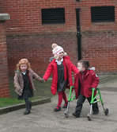
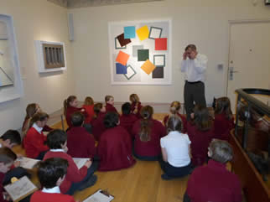
why hold a parents’ briefing?
share the key curriculum changes in Literacy and Numeracy Help parents understand how children are assessed in Wreningham school HELP parents understand the NEW end of key stage tests

Slide 4
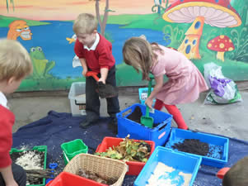
Where have we come from? The old National Curriculum
In1988 the previous National Curriculum was introduced in all state schools and prescribed what children should be taught
Progress through the curriculum could be marked by levels of achievement derived from the curriculum
End of Keystage National Curriculum tests
Level 2 as the nationally expected standard of achievement at age seven - End of key stage 1 Year 2
Level 4 as the benchmark for the majority at age 11 - End of key stage 2 Year 6
Notes:
The Context
The national curriculum is a set of subjects and standards used by primary schools so children learn the same things.
It covers what subjects are taught and the standards children should reach in each subject.

Slide 5
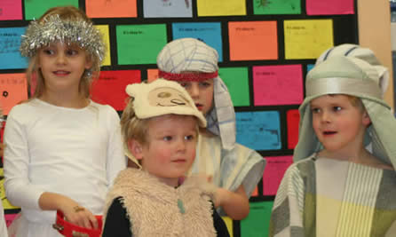
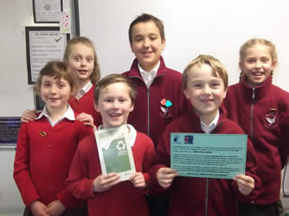
Why Remove Levels?
The DfE believed levels were difficult for parents to understand e.g. There was no correlation between a level and a child’s year group – in a Year 6 class there could be a range of levels, from level 2 to a level 6.
So a lack of clarity existed about what levels actual were other than a level 3 being better than a level 2
The DfE believed levels conveyed the wrong idea of ability
Demotivating for children
Notes:
Problems

Slide 6
Assessing without levels What we are doing Now!
A new National Curriculum was introduced in 2014 and in the new curriculum levels are no longer being used to report children’s attainment and progress
‘As part of our reforms to the national curriculum, the current system of ‘levels’ used to report children’s attainment and progress will be removed. It will not be replaced’ (DfE, 2013a)
Notes:
The new National Curriculum was introduced in September 2014
Schools will be able to introduce their own approaches to formative assessment, to support pupil attainment and progression.
(DfE, 2013a)
In their place, from September 2014, “it will be for schools to decide how they assess pupils’ progress”.

Slide 7
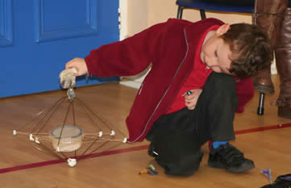
Summary of the changes to the new National Curriculum
As of September 2015, national curriculum levels are no longer used for statutory assessments.
Many of the objectives in the old curriculum have shifted to lower year groups in the new curriculum
Children study fewer things in greater depth
Focus on ‘mastery’ - every child in each year group understands fully each of the concepts expressed in the curriculum before moving on
Under the old levels system children who were exceeding might have moved into the next level. The DfE now want children who are in the exceeding bracket to add more depth and breadth to their knowledge
The arrangement of primary national curriculum is in age related statements broken down into years – Age Related Expectations
Notes:
New Curriculum ‘Reflects the curriculum in the most successful countries in the world’ DfE
Assessment goes hand-in-hand with the curriculum
Schools must develop their own effective assessment procedures without the use of levels
Assessment Policy
Rather than whether a pupil has achieved a particular level, the focus is on whether a child has understood key concepts/knowledge and skill
Focus on mastery Very secure understanding - Deep learning in the central concepts an ideas
Have more opportunities to develop their using and applying skills.
This phase of learning is Mastery and Depth - Pupils mastering the fundamental concepts in a subject
Only exceptional children will move into working towards the end of year expectations from the year above.
Similarly, children who are unlikely to be emerging at the end of the year may work towards the expectations from the year below.
The new National Curriculum sets out expectations for each year group and children will be assessed against those every year,
so a child in Year 4 will always be judged in the first instance against the expectations for the end of Year 4.

Slide 8
OUR School Curriculum
Notes:
Outdoor learning

Slide 9
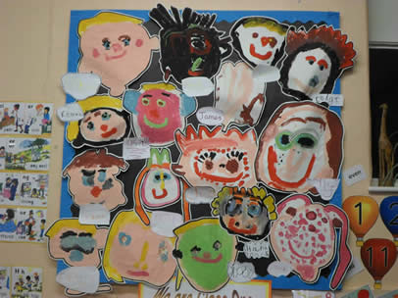
EYFS STRIVING FOR A ‘GOOD LEVEL OF DEVELOPMENT
At the end of Foundation
Emerging
Expected
Exceeding

Slide 10
New Primary Curriculum for Mathematics Aims
Fluency in the fundamentals
The ability to use mathematics efficiently, accurately and flexibly.
Example: 2x5 = 10 so 5 x 2 = 10; 2+2+2+2+2 = 10; 5+5=10, 10 ÷ 5=2 etc.
Reason mathematically
Giving reasons for their opinions, making deductions, using precise language to explain what they think, making judgements and decisions informed by reasons and evidence.
Example: Prove or disprove that when two odd numbers are added together you get an even answer.
Solve problems
Engaging with real problems; guessing, discovering, and making sense of mathematics.
Example: Noah watched the animals going into the ark. He was counting and by noon he got to 12 , but he was only counting the legs of the animals. How many creatures did he see? See if you can find other answers? Try to tell someone how you found these answers out?

Slide 11
New Primary Curriculum for Mathematics
What’s out?
Informal written methods of calculation
Calculators
Separate strand for using and applying
What’s there less of?
Emphasis on estimation
Less work on place value
Less work on data handling (statistics)
What’s in?
Roman numerals
Times tables up to 12 x 12 by the end of Year 4
Equivalence between metric and imperial
Long division and algebra (Y6)
What’s there more of?
More challenging objectives, especially in number
Formal written methods introduced earlier
More work on fractions

Slide 12
Changes to the maths curriculum: Year 2

Slide 13
Key features of the mathematics tests
The key stage 1 mathematics test will consist of two components.
Paper 1: an arithmetic paper. This will comprise of a practice question and a number of questions which will be linked to national curriculum areas such as number, calculations and fractions.

Slide 14
Paper 2: assesses pupils’ ability to apply mathematics to problems and to reason.
The test will contain a mixture of real life and abstract problems. The first question will be a practice aural question. No marks will be awarded. The next five questions will be aural questions, similar to the previous versions of the national curriculum tests. These will be read to pupils so they can become more familiar with the test environment. Pupils will work on their own for the rest of the test, unless they require access arrangements.

Slide 15
Changes to the maths curriculum: Year 6

Slide 16
The Year 6 mathematics test will consist of three papers.
Paper 1: an arithmetic paper. Questions will be context free. They will assess number, calculations and fractions. Note that the ‘fractions’ strand in the new national curriculum covers fractions, decimals and percentages.

Slide 17
Paper 2 and Paper 3: assesses pupils’ ability to apply mathematics to problems and to reason.
There won’t be significant differences in format or difficulty between the two papers. Questions will be linked to the specific strands and year group references described in the key stage 2 mathematics Test framework. The tests will contain a mixture real life and abstract problems.

Slide 18
English in KS1
Reading:
Emphasis on reading widely for pleasure, re-reading books and reading aloud;
Increased focus on engaging with and interpreting texts;
Learning of poetry (including reciting poetry) introduced.

Slide 19
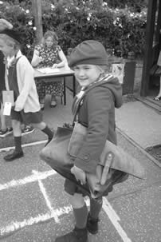
English in KS1
Writing:
Increased challenge, including developing “stamina” for writing
Longer compositions and proof-reading of own writing;
Increased focus on composition, structure and convention;
Deeper focus on learning grammar and punctuation;
Joined writing expected in Year 2.
Spelling:
Specific spellings, e.g. days of the week, prefixes & suffixes;
Pupils expected to write sentences dictated by the teacher.

Slide 20
English in KS2
Reading:
Read for pleasure;
Word reading: pupils applying their knowledge to understand the meaning of new words;
Learning of classic & modern poetry (including reciting poetry) introduced.

Slide 21
English in KS2
Writing:
Greatly increased expectations in grammar and punctuation;
Children have to identify and label complex grammatical concepts, punctuation and spelling rules;
Expectation that children expertly use and apply the grammar and punctuation concepts in independent writing to create specific effects;
Spelling:
Statutory lists of words to be learnt in Years 3 - 6;
Specific spelling rules to be taught.

Slide 23
Why Assess? Good assessment, of any form, should be clearly linked to its intended purpose. Formative & Summative assessment To be used effectively schools must understand their various purposes
FORMATIVE ASSESSMENT
Explore pupils’ understanding and identifies a pupil’s misconceptions
Used day-to-day and happens continually throughout learning
Involves pupils in their own learning
Gives children feedback about the quality of their work and
how they can improve it
It should be acted on
In Wreningham School
Examples: Talk Partners, Effective Questioning, Observational
Assessment, Marking Policy ‘Pink for Think’

Slide 24
‘Pink for Think’ marking of pupils’ work
Notes:
This is done across the curriculum
Green - Good

Slide 25
SUMMATIVE ASSESSMENT For parents, summative assessment can inform them of achievement & progress For teachers it enables them to evaluate learning at the end of a period For school leaders it allows them to monitor the performance of pupil cohorts
Builds an accurate picture of pupil attainment
Enables the progress of each pupil to be monitored and tracked
Enables pupil targets to be set
In Wreningham School
Examples Termly tests (PiRA & PUMA, SWRT/SWST)
Ros Wilson ‘Big Write’ - Writing assessment each term
Used to track pupils’ progress using Pupil Asset
Used to inform Pupil Progress Meetings

Slide 26
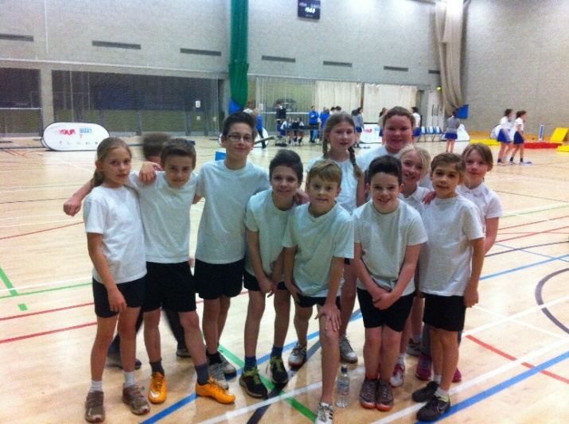
Nationally standardised summative assessment End-of-key-stage tests for KS1 & KS2
Year 2 national curriculum assessments in English - Reading, Grammar
Punctuation & Spelling, Maths test (Arithmetic/Reasoning), Teacher Assessment in Writing and Science
Year 6 national curriculum assessments in English, Maths (Arithmetic/Reasoning), Teacher Assessment in Writing and Science
From 2016, national curriculum test outcomes will no longer be reported using levels. Scaled scores will be used instead. Test scores will be converted to a scaled score with 100 representing the ‘expected standard’
Year 1 Phonics Screening Check (consists of 20 real words and 20 pseudo-words that a pupil reads aloud to the teacher)
These summative tests enable schools to benchmark against other schools locally and nationally.
Notes:
English Maths Science Art & Design Computing D&T Languages Geography History Music PE

Slide 27
Year 5 programme of study Number – number and place value
Statutory requirements
Pupils should be taught to:
▪ read, write, order and compare numbers to at least 1 000 000 and determine the value of each digit
▪ count forwards or backwards in steps of powers of 10 for any given number up to 1 000 000
▪ interpret negative numbers in context, count forwards and backwards with positive and negative whole numbers, including through zero
▪ round any number up to 1 000 000 to the nearest 10, 100, 1000, 10 000 and 100 000
▪ solve number problems and practical problems that involve all of the above
▪ read Roman numerals to 1000 (M) and recognise years written in Roman numerals.
An Example of Age Related Expectations for Year 5 Maths in the new National Curriculum

Slide 28
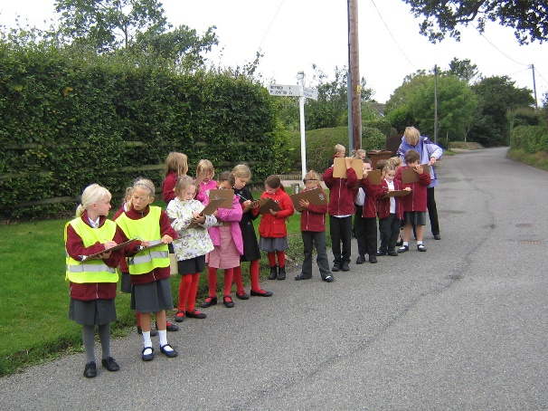
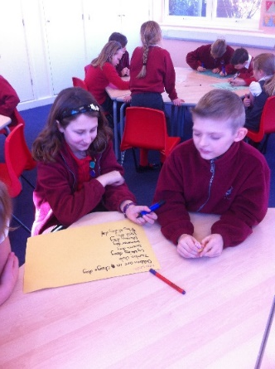
Our new assessment system Assessing without levels
In the new curriculum pupils’ attainment in all year groups will be assessed against age related expectations in the new national curriculum PoS.
We assess pupils against these age related expectations at ‘a point in time’, using terminology built around the ‘securely expected’ assessment.
Example: just below expected, below expected, expected, securely expected, greater depth, securely greater depth, exceptional
Mastery Pupils are required to demonstrate ‘mastery’ of each unit of learning
before moving on to the next.
Notes:
Assessing children against the new curriculum descriptors.
Beginning - Evidence of some aspects of the criteria (e.g. up to about 20%) - may be occasional but not yet frequent
Developing - Secure in many aspects of the criteria (e.g. up to 50/60%)
Embedded - Secure in almost all or all the end of year expectations – more than 80% of age-related objectives have been achieved. The pupil can use and apply their knowledge and skills confidently.
Mastery - Children who have securely met the end of year objectives will be assessed as exceeding or ‘mastering’ objectives for their age group. Rather than moving onto the next year’s curriculum these children will work on ‘mastering’ their knowledge through the application of skills in different contexts – they will be deepening their learning
Depending on time of year

Slide 29
Ros Wilson ‘Big Write!’
1 Can communicate ideas and meaning confidently in a series of sentences (may not be accurate, but mainly ‘flows’ as it has lost the ‘list like’ form typical of some early writing, at least a paragraph in length.
2 Can control use of ascenders/descenders and upper/lower case letters in handwriting.
3 Can write in three or more text forms or genres with reasonable accuracy. If the writing is a narrative, simple report or recount of a known story this can’t be ticked. If another genre, it can be as they will already know those three.
Notes:
Parents consultation meeting
Sharing targets
At the end of the year teachers will be saying where your child is in terms of ARE

