Slide 1
Year 1 Phonics Screening Check

Slide 2
What is the Year 1 phonics screening check?
Children in Year 1 throughout the country will all be taking part in a phonics screening check during the same week in June. Children in Year 2 will also take the check if they did not achieve the required result when in Year 1 or they have not taken the test before.

Slide 3
What is in the phonics screening check?
There are two sections in this 40-word check and it assesses phonics skills and knowledge learned through Reception and Year 1.
Your child will read up to four words per page and they will probably do the check in one sitting of about 5-10 minutes.

Slide 4
What does it check?
It checks that your child can:
Sound out and blend graphemes in order to read simple words.
Read phonically decodable one-syllable and two-syllable words, e.g. cat, sand, windmill.
Read a selection of nonsense/pseudo words.

Slide 5
Glossary
Phoneme - The smallest unit of sound. There are approximately 44 phonemes in English (it depends on different accents). Phonemes can be put together to make words.
Grapheme - A way of writing down a phoneme. Graphemes can be made up from 1 letter e.g. p, 2 letters e.g. sh, 3 letters e.g. tch or 4 letters e.g ough.
GPC - This is short for Grapheme Phoneme Correspondence. Knowing a GPC means being able to match a phoneme to a grapheme and vice versa.
Digraph - A grapheme containing two letters that makes just one sound (phoneme) e.g. ai, ee, ie, oa, ue.
Trigraph - A grapheme containing three letters that makes just one sound (phoneme) e.g. igh.

Slide 6
Oral Blending - This involves hearing phonemes and being able to merge them together to make a word. Children need to develop this skill before they will be able to blend written words.
Blending- This involves looking at a written word, looking at each grapheme and using knowledge of GPCs to work out which phoneme each grapheme represents and then merging these phonemes together to make a word. This is the basis of reading.
Oral Segmenting - This is the act hearing a whole word and then splitting it up into the phonemes that make it. Children need to develop this skill before they will be able to segment words to spell them.
Segmenting - This involves hearing a word, splitting it up into the phonemes that make it, using knowledge of GPCs to work out which graphemes represent those phonemes and then writing those graphemes down in the right order. This is the basis of spelling.

Slide 7
What are nonsense or pseudo words and why are they included?
These are words that are phonically decodable but are not actual words with an associated meaning e.g. brip, snorb.
Pseudo words are included in the check specifically to assess whether your child can decode a word using phonics skills and not their memory.

Slide 8
The pseudo words is shown with a picture of a monster which tells them it’s a nonsense word.
This not only makes the check a bit more fun, but provides the children with a context for the nonsense word which is independent from any existing vocabulary they may have.
Crucially, it does not provide any clues, so your child just has to be able to decode it. Children generally find nonsense amusing so they will probably enjoy reading these words.

Slide 9
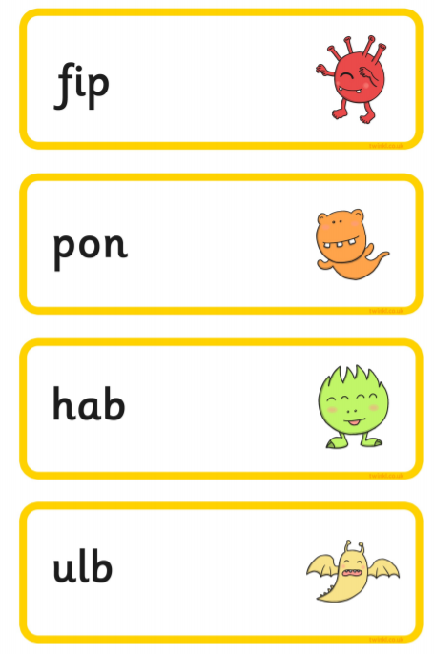
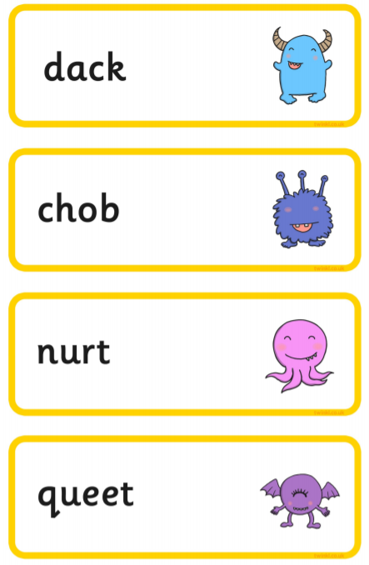

Slide 10
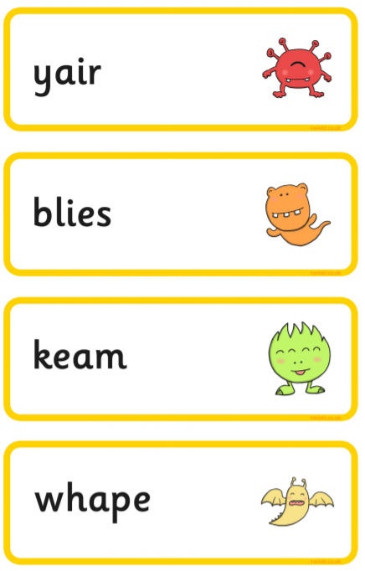
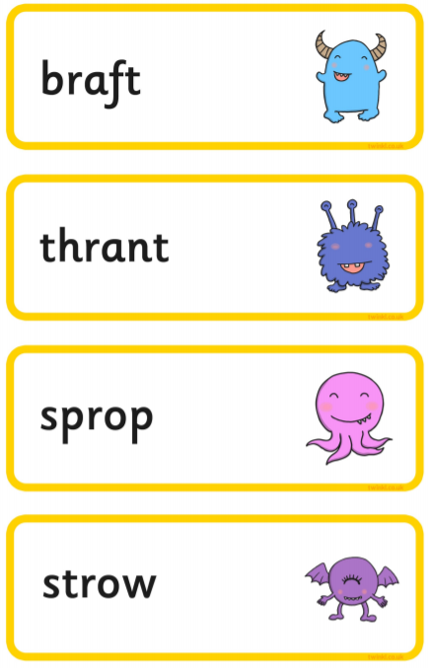

Slide 11
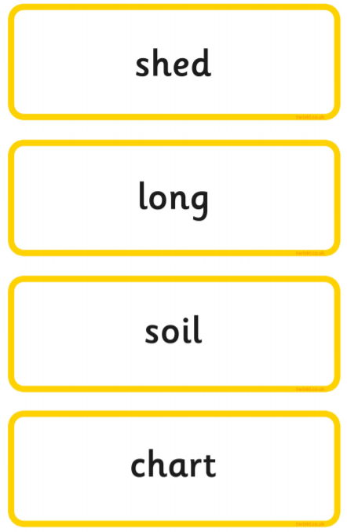
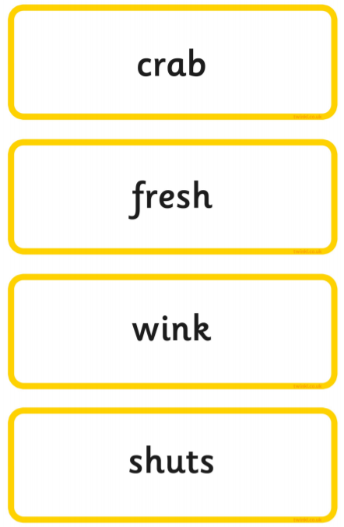

Slide 12
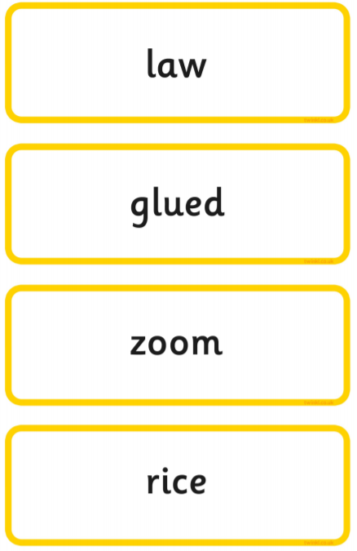
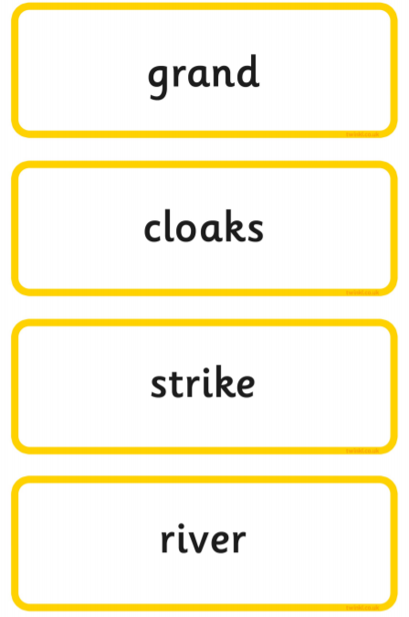

Slide 13
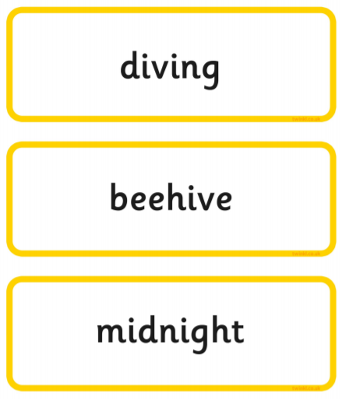

Slide 14
These are words which a lot of children, in the recent practice checks, found tricky: fighters, pumpkin, stripe, crowds, rude, brown, nigh, scroy, strad, thrand, clisk, tabe, yewn, clain, jair, dress, harnd, bulm, thard, foid, slirt, weaf, pobe, splote, twice, strike, saucers.

Slide 15
These are the sounds that often trip the children up:
or ar er ir
ea igh
oi
Split diagraphs - o_e a_e e_e i_e u_e
c/s eg. saucer, circus, twice
au aw

Slide 16
These graphemes will be practised in our phonics sessions in school.
Quite understandably, children can struggle to read nonsense words as they try to make them make sense as when reading a book. With this in mind we will be focussing on reading nonsense words during phonics.

Slide 17
Is there a pass mark?
The check is not about passing or failing but checking appropriate progress is being made. If children do not reach the required standard we will look at ways which we can support them.
Children progress at different speeds so not reaching the threshold score does not mean there is a serious problem. Your child will re-sit the check the following summer term.
In the years 2013-2017 the "pass threshold" was 32, which means children had to read at least 32 words out of 40 correctly.

Slide 18
What happens to the results?
The school will report your child’s results to you at the end of the summer term in our school reports, as well as to the local authority.
The results won’t be published in a league table as with SATs.
If you have any concerns please do talk to us in school.

Slide 19
Do all schools and children have to participate?
All schools and academies in England must take part in the phonics screening check unless they are an independent school.
Usually all children are expected to participate although there is a process in place for reviewing children with special educational needs.

Slide 20
What can I do to help my child?
Read, read, read, read and read!
Encourage your child to read lots at home.
Practise the sound cards that will be handed out.
Please return these to school at the end of the school year. They take a lot of time to make up each year!
Make real and nonsense words with the sounds.
Two good websites:
https://www.phonicsplay.co.uk/Phase3Menu.htm
http://more2.starfall.com/n/level-a/learn-to-read/load.htm.
Remember that the check is not until June so we still have lots of time to learn.

Slide 21
What should I do if my child is struggling to decode a word?
Say each sound in the word from left to right.
Point to the graphemes as you blend them; i.e. b-a-t, bat, s-igh, sigh, then run your finger under the whole word as you say it.
Talk about the meaning if your child does not understand the word they have read.
Work at your child’s pace.
Always be positive and give lots of praise and encouragement.

