Slide 1
Year 1/2 – Spring Block 3 – Length and Height – Step 6
About This Resource:
This PowerPoint has been designed to support your teaching of this small step from the Mixed Age planning. It includes a starter activity suitable for each year group and an example of each question from the Varied Fluency and Reasoning and Problem Solving resources also provided in this pack (separate for each year group). Each slide has the year group identified in the bottom right-hand corner. We recommend that you look through this PowerPoint in advance and decide whether to work through all examples provided or a selection of them depending on the needs of your class.
National Curriculum Objectives:
Mathematics Year 2: (2M1) Compare and order lengths, mass, volume/capacity and record the results using >, < and =
Mathematics Year 2: (2M2) Choose and use appropriate standard units to estimate and measure length/height in any direction (m/cm); mass (kg/g); temperature (°C); capacity (litres/ml) to the nearest appropriate unit using rulers, scales, thermometers and measuring vessels
More Year 1 and 2 Length and Height resources.
Did you like this resource? Don’t forget to review it on our website.
© Classroom Secrets Limited 2019

Slide 2
Year 1/2 – Spring Block 3 – Length and Height
Step 6
Year 2: Four Operations with Length
© Classroom Secrets Limited 2019

Slide 3
Introduction
9 + 5 =
12
25 – 12 =
13
3 x 5 =
14
24 ÷ 2 =
15
Y2
© Classroom Secrets Limited 2019

Slide 4
Introduction
9 + 5 =
12
25 – 12 =
13
3 x 5 =
14
24 ÷ 2 =
15
Y2
© Classroom Secrets Limited 2019

Slide 5
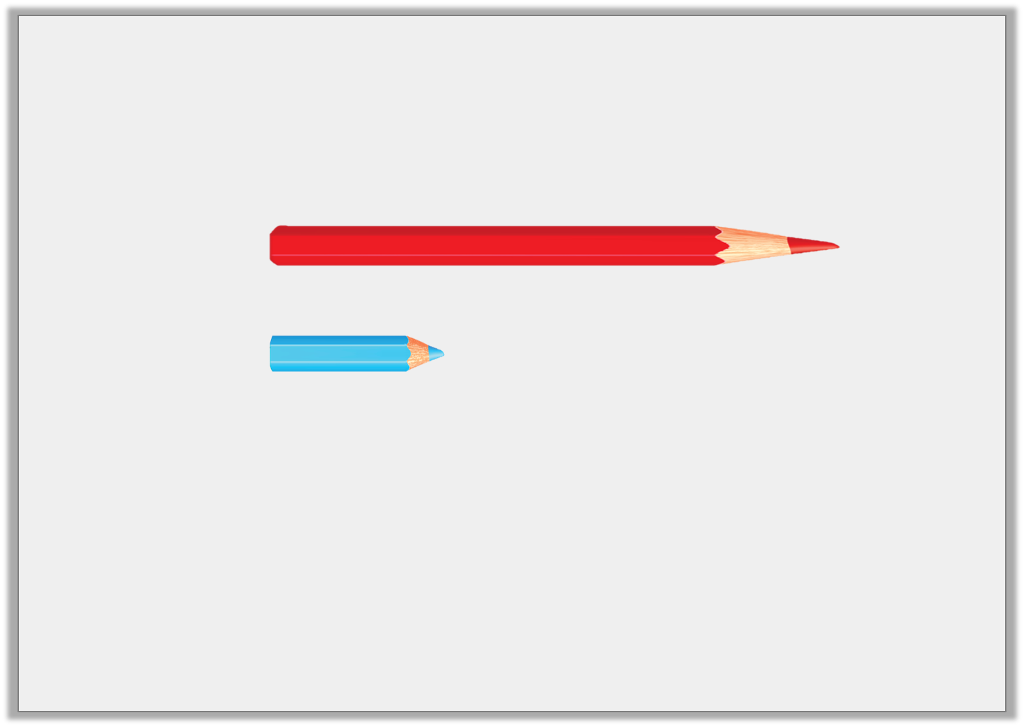
Varied Fluency 1
Eva has a pencil that is 40cm long. Poppy’s pencil is 4 times shorter than Eva’s.
Circle how long Poppy’s pencil is.
not to scale
14cm |  | 10cm |  | 4cm
Y2
© Classroom Secrets Limited 2019

Slide 6
Varied Fluency 1
Eva has a pencil that is 40cm long. Poppy’s pencil is 4 times shorter than Eva’s.
Circle how long Poppy’s pencil is.
not to scale
14cm |  | 10cm |  | 4cm
Y2
© Classroom Secrets Limited 2019

Slide 7
Varied Fluency 2
True or false?
The tallest tower is 16cm taller than the shortest flower.
not to scale
18cm |  | 22cm |  | 6cm
Y2
© Classroom Secrets Limited 2019

Slide 8
Varied Fluency 2
True or false?
The tallest tower is 16cm taller than the shortest flower.
True. 22 – 6 = 16
not to scale
18cm |  | 22cm |  | 6cm
Y2
© Classroom Secrets Limited 2019

Slide 9
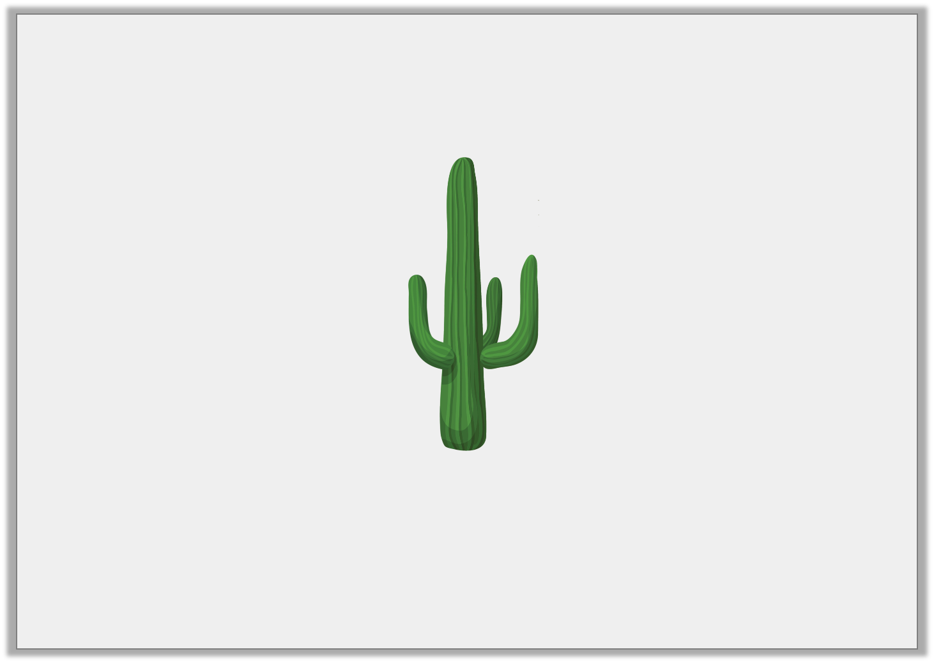
Varied Fluency 3
The cactus is 3m tall.
How tall will the cactus be if it grows double in height?
not to scale
Y2
© Classroom Secrets Limited 2019

Slide 10
Varied Fluency 3
The cactus is 3m tall.
How tall will the cactus be if it grows double in height?
6m
not to scale
Y2
© Classroom Secrets Limited 2019

Slide 11
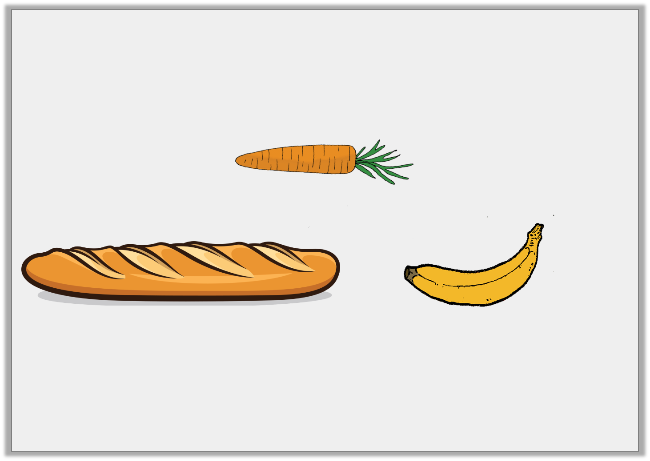
Varied Fluency 4
Which two objects added together total 80cm?
not to scale
carrot 22cm
baguette 59cm
banana 21cm
Y2
© Classroom Secrets Limited 2019

Slide 12
Varied Fluency 4
Which two objects added together total 80cm?
The baguette and the banana. 59 + 21 = 80.
not to scale
carrot 22cm
baguette 59cm
banana 21cm
Y2
© Classroom Secrets Limited 2019

Slide 13
Problem Solving 1
Rosie and Jim are threading beads onto string.
Rosie’s string is 20cm long.
Jim’s string is longer than Rosie’s.
When added together, their string measures between 51cm and 54cm long.
How long could Jim’s string be?
Y2
© Classroom Secrets Limited 2019

Slide 14
Problem Solving 1
Rosie and Jim are threading beads onto string.
Rosie’s string is 20cm long.
Jim’s string is longer than Rosie’s.
When added together, their string measures between 51cm and 54cm long.
How long could Jim’s string be?
Various possible answers; 31cm, 32cm, 33cm and 34cm.
Y2
© Classroom Secrets Limited 2019

Slide 15
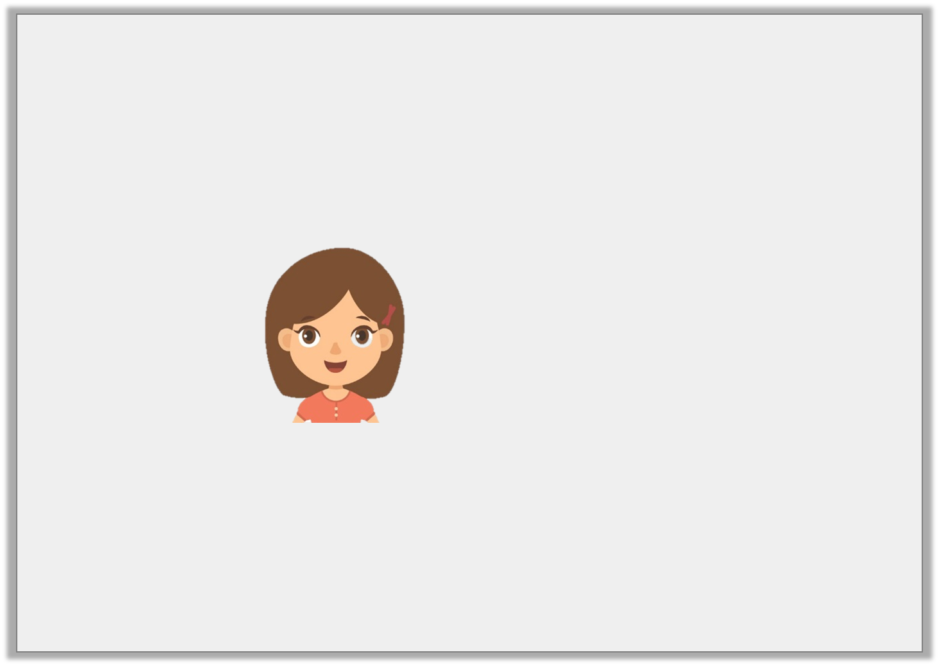
Reasoning 1
Is Ella correct? Explain why.
I have a piece of rope that is 10cm long. Todd’s rope is 5 times longer than mine. Together, our ropes are 55cm long.
Y2
© Classroom Secrets Limited 2019

Slide 16
Reasoning 1
Is Ella correct? Explain why.
Ella is incorrect because…
I have a piece of rope that is 10cm long. Todd’s rope is 5 times longer than mine. Together, our ropes are 55cm long.
Y2
© Classroom Secrets Limited 2019

Slide 17
Reasoning 1
Is Ella correct? Explain why.
Ella is incorrect because…
10 x 5 = 50
50 + 10 = 60cm
I have a piece of rope that is 10cm long. Todd’s rope is 5 times longer than mine. Together, our ropes are 55cm long.
Y2
© Classroom Secrets Limited 2019

Slide 18
Problem Solving 2
Stan is building towers using forty 1cm cubes. His first tower is 22cm tall. His second tower is half the size of the first tower.
How tall is the second tower?
How many cubes does he have left?
Y2
© Classroom Secrets Limited 2019

Slide 19
Problem Solving 2
Stan is building towers using forty 1cm cubes. His first tower is 22cm tall. His second tower is half the size of the first tower.
How tall is the second tower? 11cm
How many cubes does he have left? 7 cubes
Y2
© Classroom Secrets Limited 2019

