Slide 1
Year 1/2 – Spring Block 4 – Weight and Volume – Step 2
About This Resource:
This PowerPoint has been designed to support your teaching of this small step from the Mixed Age planning. It includes a starter activity suitable for each year group and an example of each question from the Varied Fluency and Reasoning and Problem Solving resources also provided in this pack (separate for each year group). Each slide has the year group identified in the bottom right-hand corner. We recommend that you look through this PowerPoint in advance and decide whether to work through all examples provided or a selection of them depending on the needs of your class.
National Curriculum Objectives:
Mathematics Year 1: (1M1) Compare, describe and solve practical problems for: lengths and heights [for example, long/short, longer/shorter, tall/short, double/half] mass/weight [for example, heavy/light, heavier than, lighter than] capacity and volume [for example, full/empty, more than, less than, half, half full, quarter] Time [for example, quicker, slower, earlier, later]
Mathematics Year 1: (1M2) Measure and begin to record: lengths and heights mass/weight capacity and volume time (hours, minutes, seconds)
Mathematics Year 2: (2M1) Compare and order lengths, mass, volume/capacity and record the results using >, < and =
Mathematics Year 2: (2M2) Choose and use appropriate standard units to estimate and measure length/height in any direction (m/cm); mass (kg/g); temperature (°C); capacity (litres/ml) to the nearest appropriate unit, using rulers, scales, thermometers and measuring vessels
More Year 1 and 2 Weight and Volume resources.
Did you like this resource? Don’t forget to review it on our website.
© Classroom Secrets Limited 2019

Slide 2
Year 1/2 – Spring Block 4 – Weight and Volume
Step 2
Year 1: Measure Mass
Year 2: Measure Mass in Grams
© Classroom Secrets Limited 2019

Slide 3
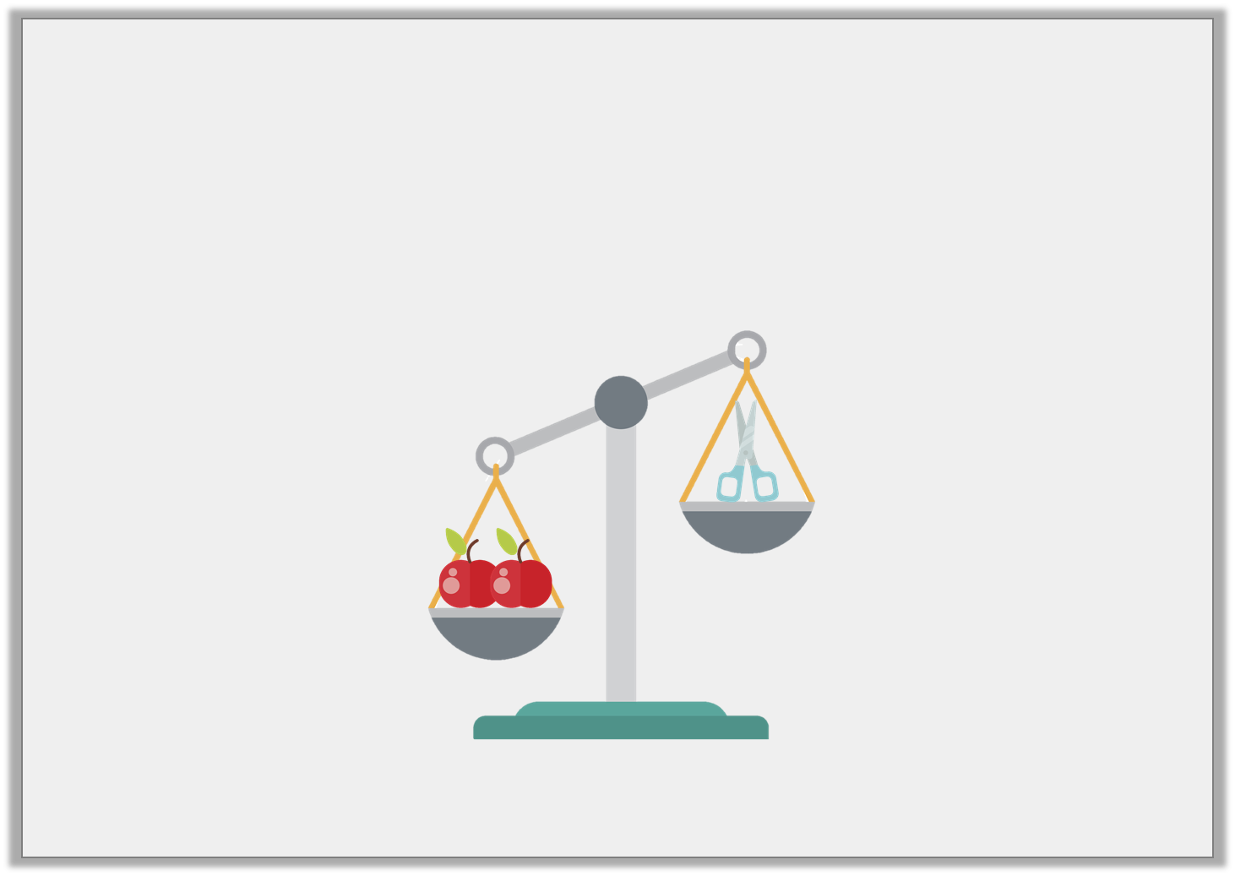
Introduction
Fill in the blanks using the words on the cards.
The scissors are _________________________________ than the apples.
The apples are _________________________________ than the scissors.
heavier
lighter
Y1
© Classroom Secrets Limited 2019

Slide 4
Introduction
Fill in the blanks using the words on the cards.
The scissors are _________________________________ than the apples.
The apples are _________________________________ than the scissors.
lighter
heavier
heavier
lighter
Y1
© Classroom Secrets Limited 2019

Slide 5
Introduction
What number each arrow pointing to?
0 | 10 |  | 30 |  | 50 |  | 70 |  | 90 | 100
0 | 2 | 4 |  | 8 | 10 | 12 |  | 16 | 18 | 20
0 | 5 | 10 |  | 20 | 25 |  | 35 | 40 |  | 50
Y2
© Classroom Secrets Limited 2018

Slide 6
Introduction
What number each arrow pointing to?
0 | 10 |  | 30 | 40 | 50 |  | 70 |  | 90 | 100
0 | 2 | 4 |  | 8 | 10 | 12 | 14 | 16 | 18 | 20
0 | 5 | 10 |  | 20 | 25 |  | 35 | 40 | 45 | 50
Y2
© Classroom Secrets Limited 2018

Slide 7
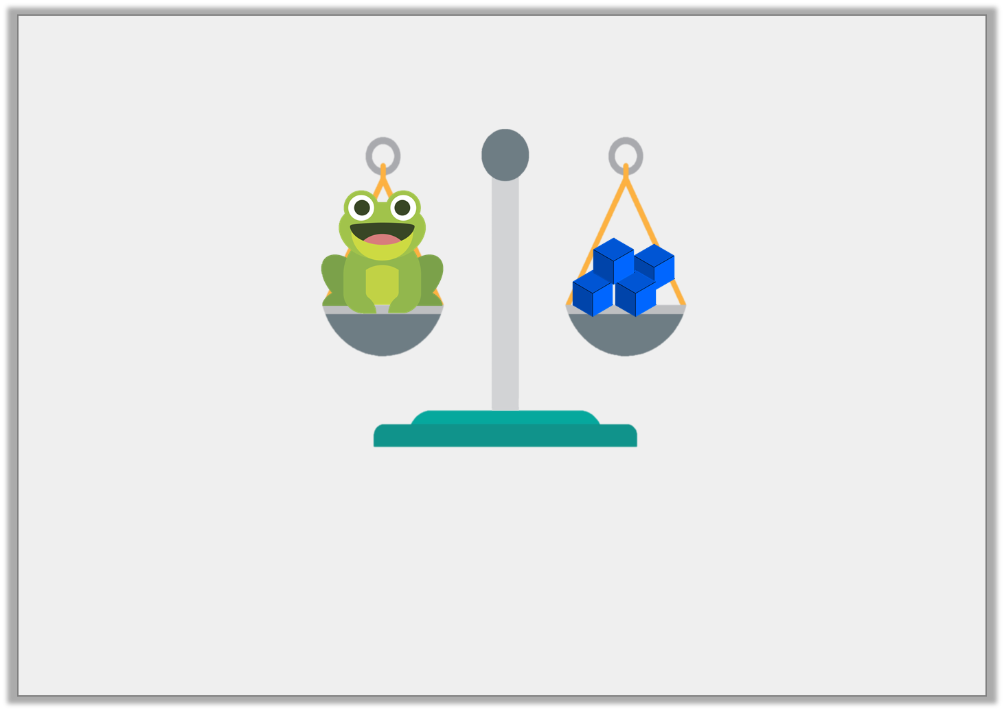
Varied Fluency 1
What is the mass of the toy frog?
cubes
Y1
© Classroom Secrets Limited 2019

Slide 8
Varied Fluency 1
What is the mass of the toy frog?
cubes
4
Y1
© Classroom Secrets Limited 2019

Slide 9
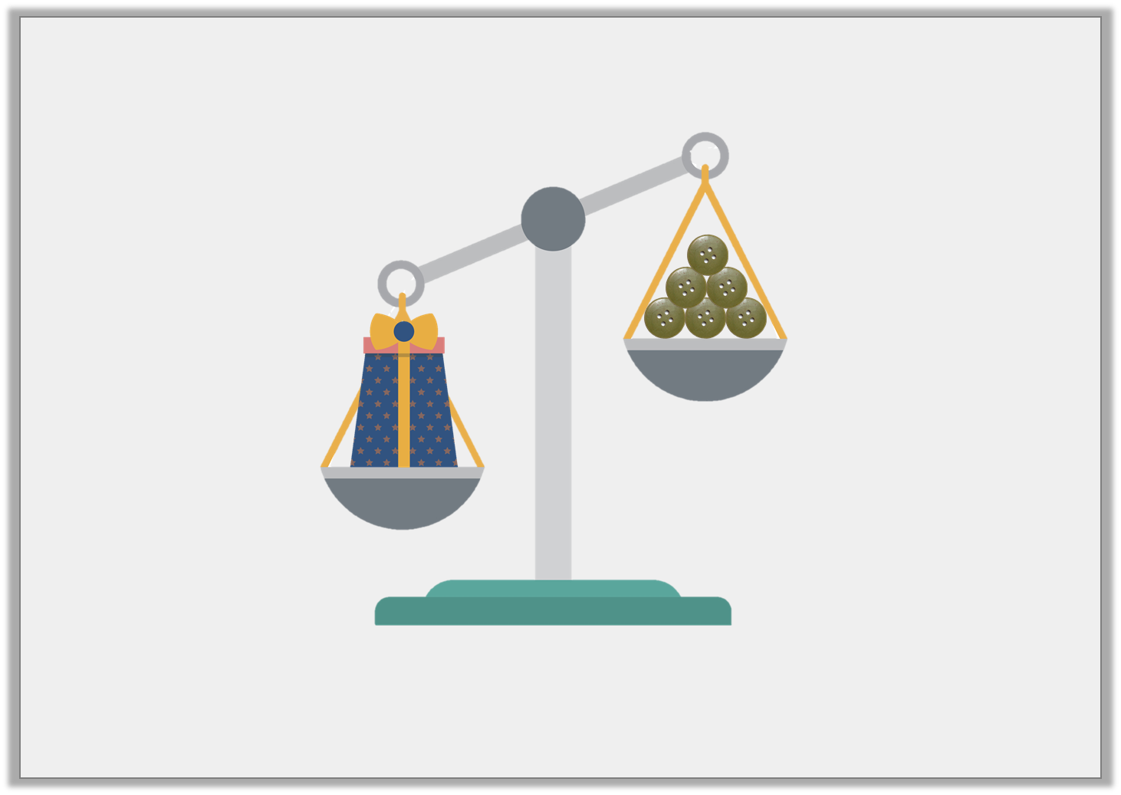
Varied Fluency 2
True or false? This box weighs less than 6 buttons.
Y1
© Classroom Secrets Limited 2019

Slide 10
Varied Fluency 2
True or false? This box weighs less than 6 buttons.
False, the box weighs more than 6 buttons.
Y1
© Classroom Secrets Limited 2019

Slide 11
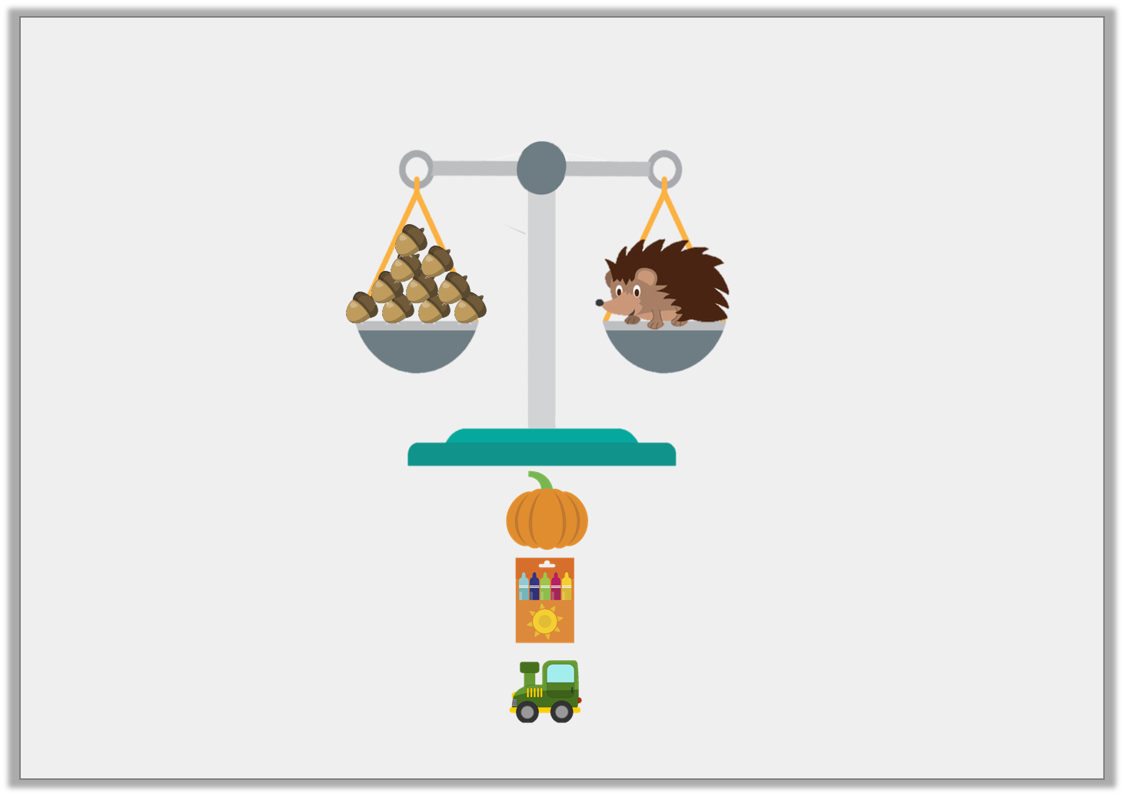
Varied Fluency 3
Which object weighs more than the hedgehog?
pumpkin
crayons
toy
12 acorns
8 acorns
10 acorns
Y1
© Classroom Secrets Limited 2019

Slide 12
Varied Fluency 3
Which object weighs more than the hedgehog?
pumpkin
crayons
toy
12 acorns
8 acorns
10 acorns
Y1
© Classroom Secrets Limited 2019

Slide 13
Varied Fluency 1
Order these amounts from smallest to largest.
62g |  | 48g |  | 46g
Y2
© Classroom Secrets Limited 2018

Slide 14
Varied Fluency 1
Order these amounts from smallest to largest.
46g, 48g, 62g
62g |  | 48g |  | 46g
Y2
© Classroom Secrets Limited 2018

Slide 15
Varied Fluency 2
Complete the sentence using ‘more’ or ‘less’.
The duck weighs _______ than the yo-yo.
240g
56g
Y2

Slide 16
Varied Fluency 2
Complete the sentence using ‘more’ or ‘less’.
The duck weighs _______ than the yo-yo.
less
240g
56g
Y2

Slide 17
Varied Fluency 3
Circle the object that weighs the most.
108g
424g
362g
Y2

Slide 18
Varied Fluency 3
Circle the object that weighs the most.
108g
424g
362g
Y2

Slide 19
Varied Fluency 4
How much do these items weigh?
Y2

Slide 20
Varied Fluency 4
How much do these items weigh?
110g
140g
Y2

Slide 21
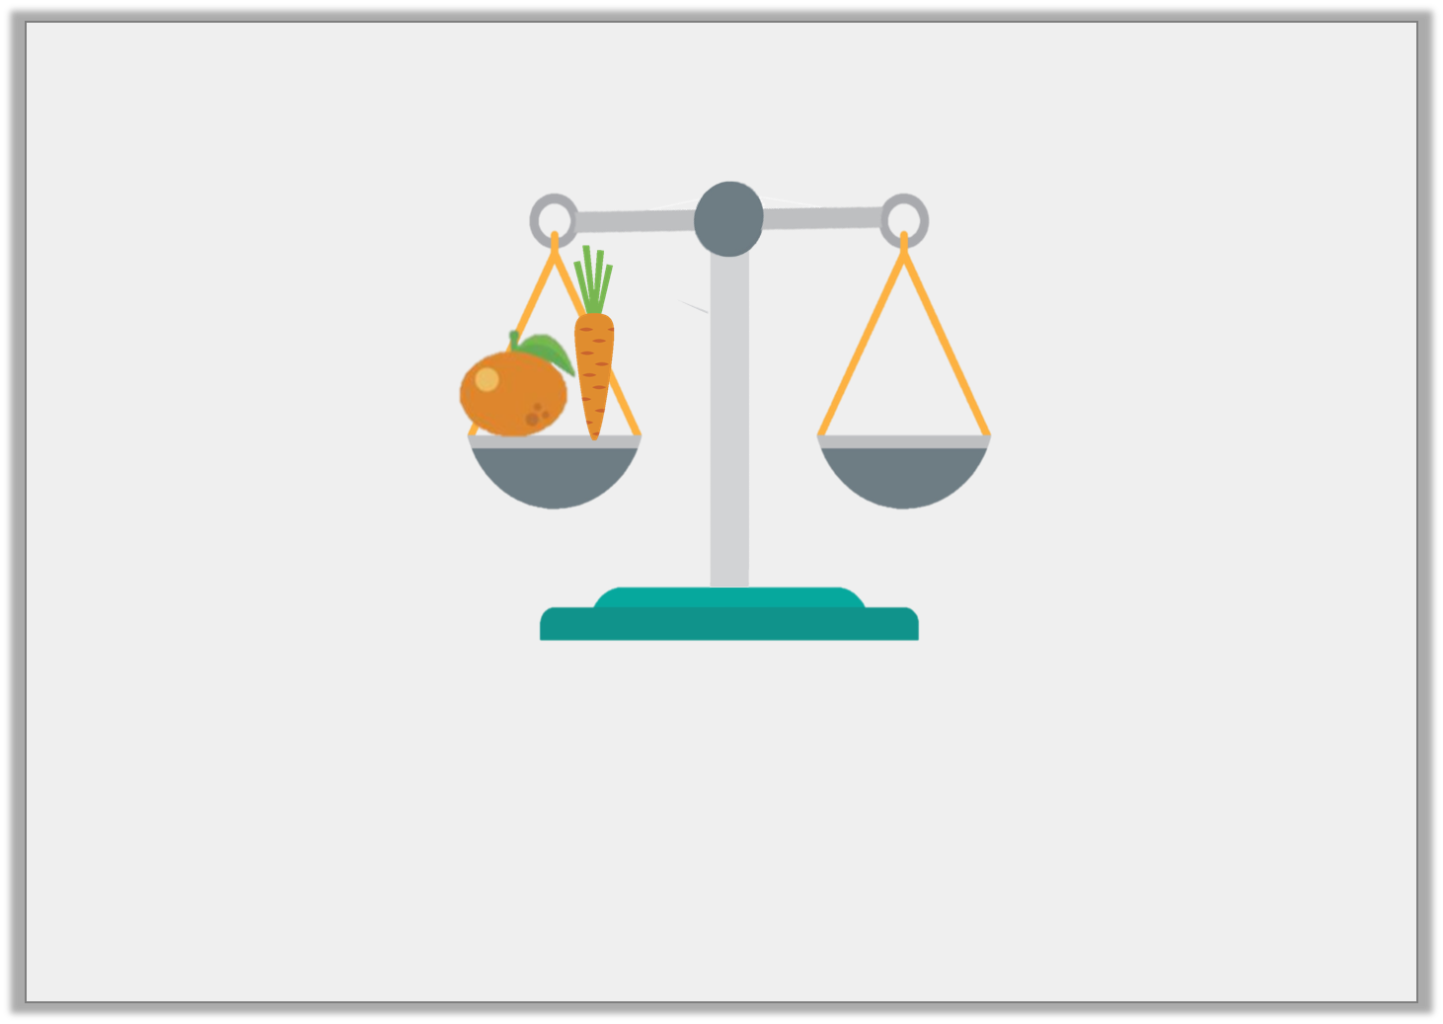
Problem Solving 1
The orange weighs 7 blocks and the carrot weighs 5 blocks.
Draw the blocks to balance the scale.
© Classroom Secrets Limited 2019

Slide 22
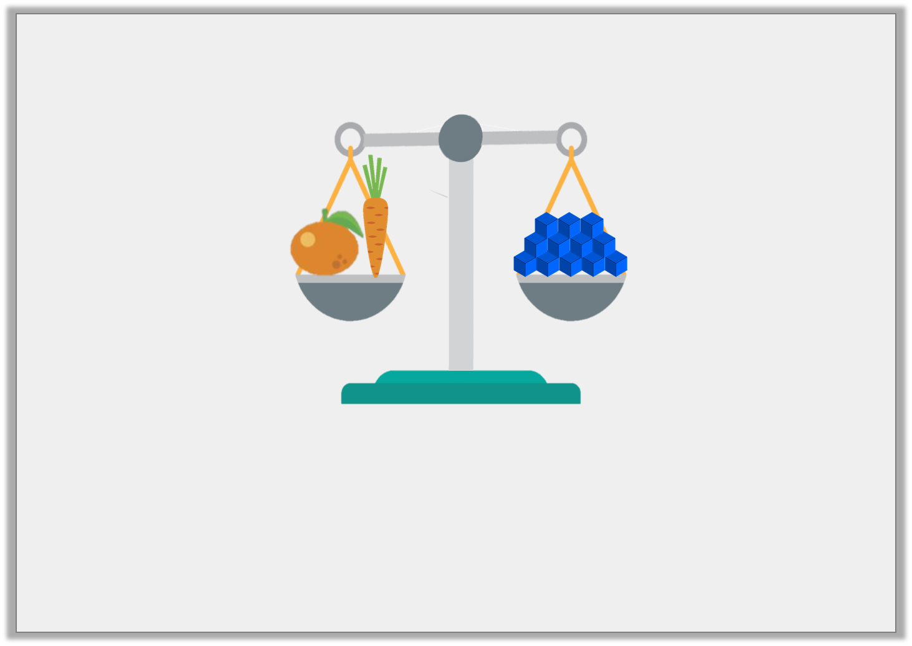
Problem Solving 1
The orange weighs 7 blocks and the carrot weighs 5 blocks.
Draw the blocks to balance the scale.
12 blocks should be drawn on the scale.
Y1
© Classroom Secrets Limited 2019

Slide 23
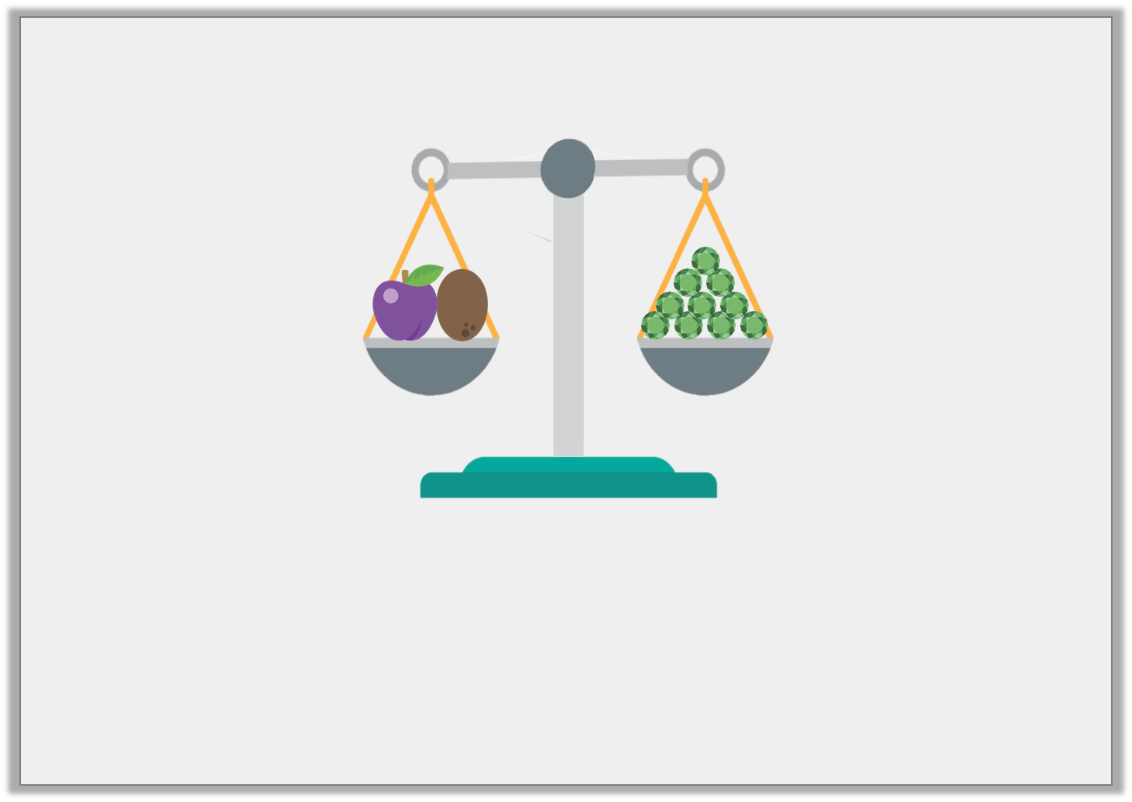
Problem Solving 2
The plum and the kiwi weigh 10 jewels.
Find 3 possible combinations for the mass of the plum and the kiwi.
Y1
© Classroom Secrets Limited 2019

Slide 24
Problem Solving 2
The plum and the kiwi weigh 10 jewels.
Find 3 possible combinations for the mass of the plum and the kiwi.
Various answers, for example: plum 4 jewels, kiwi 6 jewels, or plum 3 jewels, kiwi 7 jewels, or plum 9 jewels, kiwi 1 jewel
Y1
© Classroom Secrets Limited 2019

Slide 25
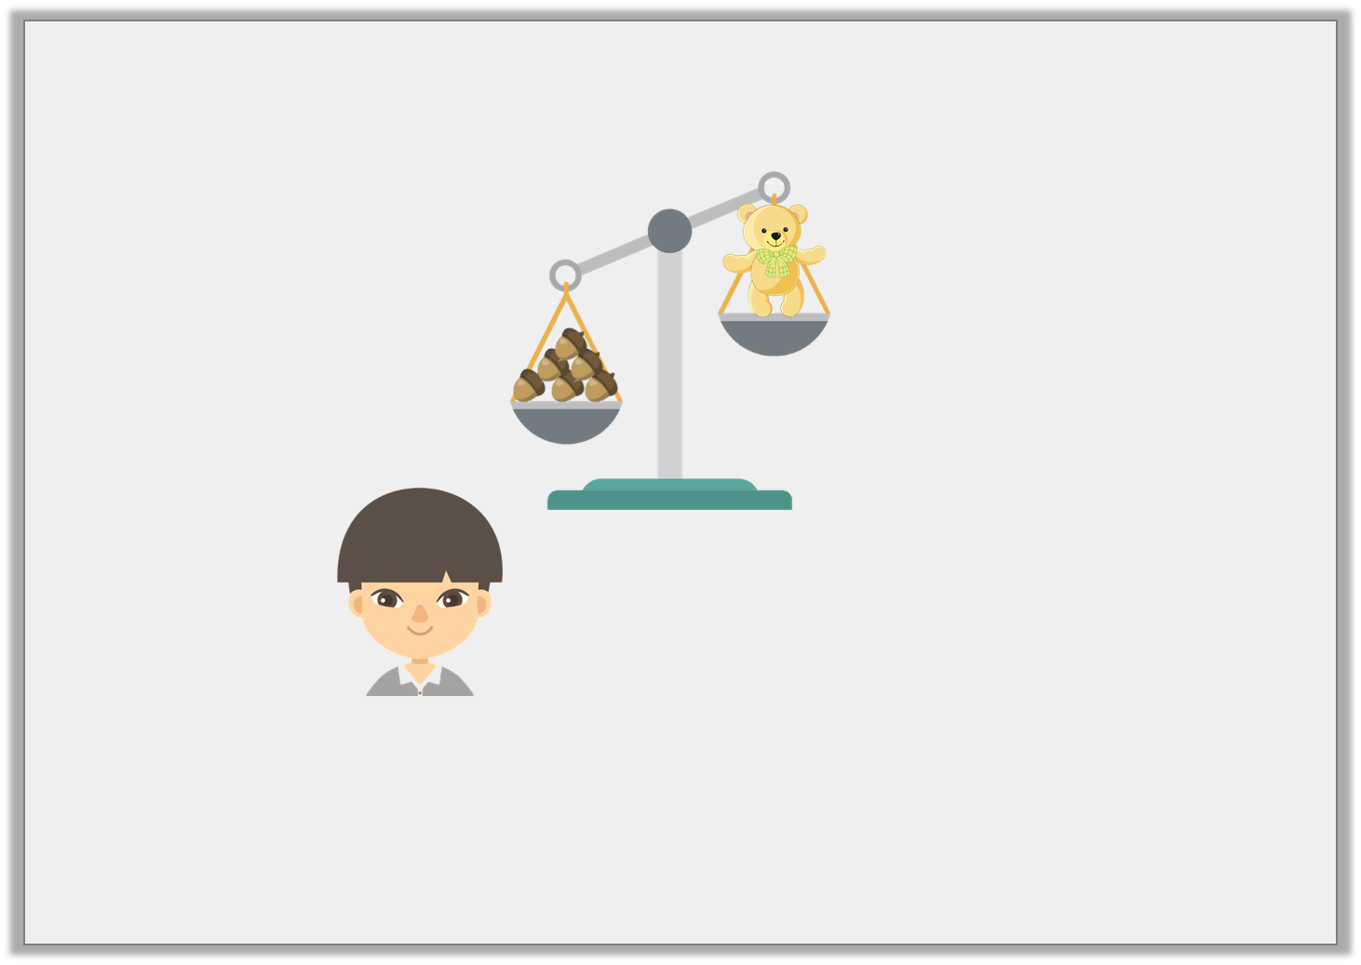
Reasoning 1
Cheng is weighing objects. He says,
Is he correct? Explain your answer.
I think 1 more acorn will balance the scale.
Y1
© Classroom Secrets Limited 2019

Slide 26
Reasoning 1
Cheng is weighing objects. He says,
Is he correct? Explain your answer.
No, he is not correct because…
I think 1 more acorn will balance the scale.
Y1
© Classroom Secrets Limited 2019

Slide 27
Reasoning 1
Cheng is weighing objects. He says,
Is he correct? Explain your answer.
No, he is not correct because the acorns are already heavier than the teddy. He would need to remove acorns to balance the scale.
I think 1 more acorn will balance the scale.
Y1
© Classroom Secrets Limited 2019

Slide 28
Problem Solving 1
The flour weighs 30g more than the eggs.
How much does the flour weigh?
?
54g
Y2

Slide 29
Problem Solving 1
The flour weighs 30g more than the eggs.
How much does the flour weigh?
84g
54g
Y2

Slide 30
Problem Solving 2
The beans weigh less than the biscuits but more than the tuna.
How much could the beans weigh?
Y2

Slide 31
Problem Solving 2
The beans weigh less than the biscuits but more than the tuna.
How much could the beans weigh?
Any amount between 101g and 139g.
Y2

Slide 32
Reasoning 1
Annie’s toy weighs 96g and Olly’s toy weighs 86g.
Who do you agree with? Why?
My toy weighs 10g more than yours.
My toy weighs 10g more than yours.
Olly
Annie
Y2

Slide 33
Reasoning 1
Annie’s toy weighs 96g and Olly’s toy weighs 86g.
Who do you agree with? Why?
I agree with Annie because...
My toy weighs 10g more than yours.
My toy weighs 10g more than yours.
Olly
Annie
Y2

Slide 34
Reasoning 1
Annie’s toy weighs 96g and Olly’s toy weighs 86g.
Who do you agree with? Why?
I agree with Annie because 96g is 10 more than 86g.
My toy weighs 10g more than yours.
My toy weighs 10g more than yours.
Olly
Annie
Y2

